Slide 1

5 things you can do with GitHub Copilot
Daniel Scott-Raynsford
Sr. Solution Architect, AI & Data | Microsoft
https://www.linkedin.com/in/dscottraynsford/

Slide 2
Our Agenda
1
The Copilot Effect
DevEx
2
How It Works
A 2-minute overview
3
The Demos
5 ways I stay in the flow

Slide 3



The Copilot effect
It’s all about staying in the flow…
Maximize developer everyone’s happiness
Increase developer everyone’s productivity
Accelerate software development delivery

Slide 4
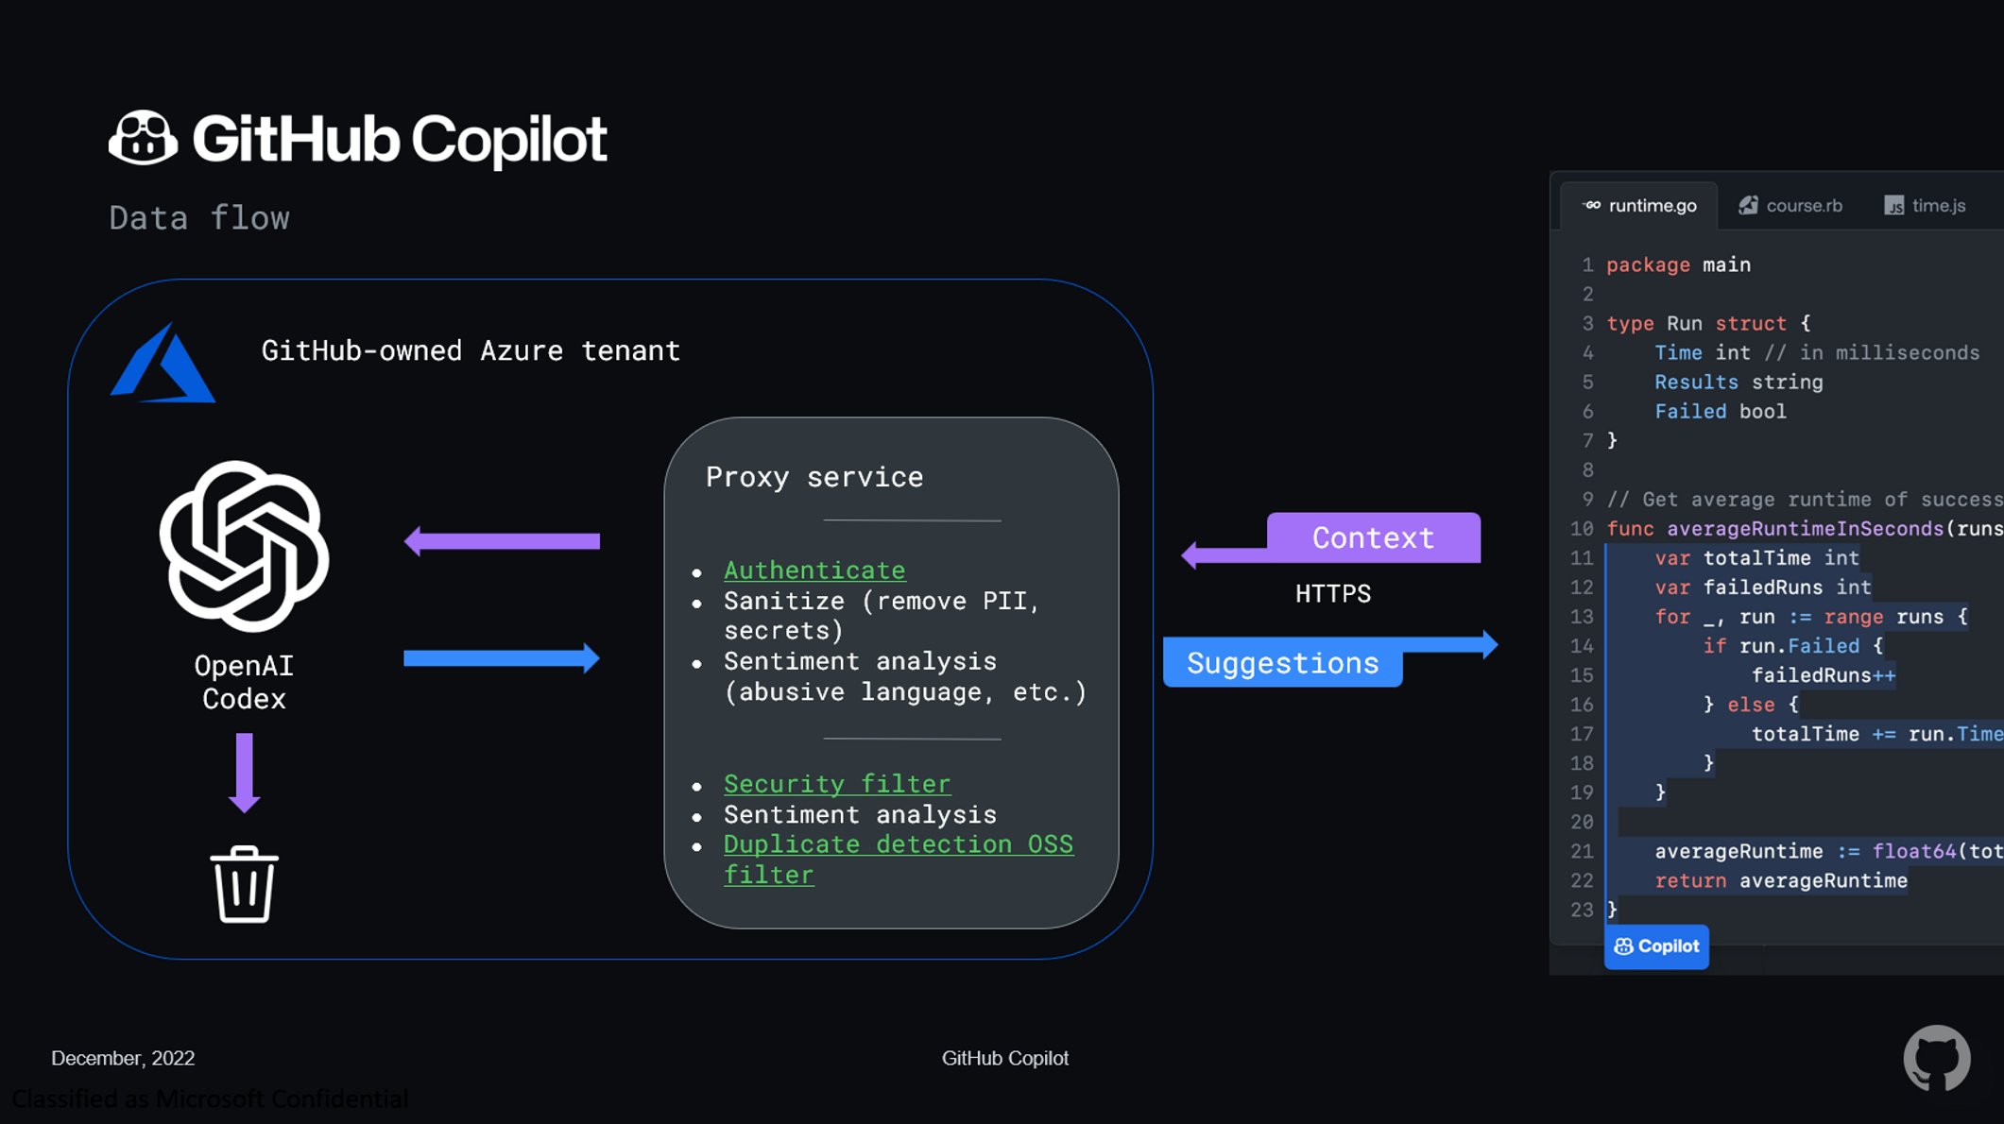

Slide 5
Demos
Disclaimers:
I’m using C# and PowerShell. But pretty much all languages work. Yeah, even Cobol.
The patterns I’m using are typical in real large-scale, production apps.
I’m using VS Code, but you can use IntelliJ, NeoVim, VS if you prefer.
I prayed to the demo gods. But this is non-deterministic technology... so… yeah.

Slide 6

Align tests and code to your patterns
GitHub Copilot / Test Automation
Tests need to align to standards
Test intent over function
Write more testable code

Slide 7
Write RegEx with contextual conversations
GitHub Copilot / RegEx
Create context specific regex
Regex from example
Regex from reference

Slide 8
Refactor code for perf, clean code, functionality
GitHub Copilot / Refactoring
Apply SOLID
Rewrite with pattern
Notes:
GitHub Copilot is able to provide assistance right in the terminal. Need help with multi-step shell commands and scripting? Just explain what you want to do and Copilot is there to help.

Slide 9
DevOps techniques
GitHub Copilot / IaC, Pipelines and SRE
Create/update Infrastructure as Code
Create/update CI/CD workflows & pipelines
Suggest reliability improvements and monitoring

Slide 10
Techniques for architects and senior developers
GitHub Copilot / Architects and Senior Devs
Assist with education of engineers
Clean code and design recommendations prior to submission
Creation of technical documentation

Slide 11



Thank You!

